Slide 1
Finova
A personal Finance Management App that helps you grow.

Slide 2
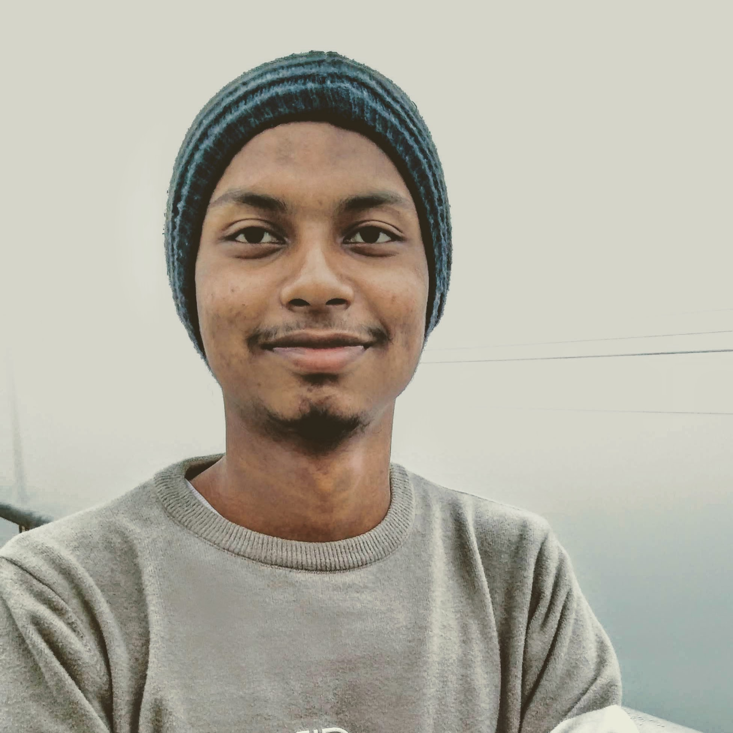
The Team
Akhlak Hossain Jim
2022-3-60-057
Department of CSE

Slide 3
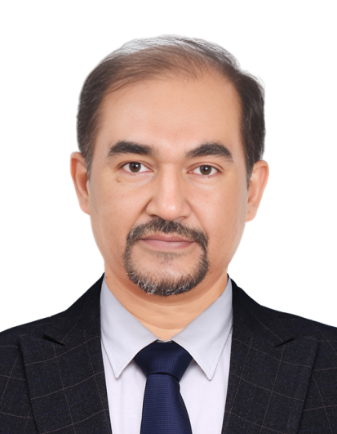
Instructor
Dr. Shamim H Ripon
Professor
Department of CSE

Slide 4

Table of Contents
Introduction
Planning
  Features
  Requirements
  Tools and Technologies
  Workplace
Conclusion

Slide 5
Introduction

Slide 6
Project Focus
Development of Finova, a culturally-aware personal finance mobile app that empowers individuals and families to manage expenses, income, savings goals, and financial habits.

Slide 7
Importance
Addresses gaps in existing apps by integrating cultural spending patterns and family financial management, promoting financial literacy and wellness.

Slide 8
Planning
Enhance your Personal Finance.

Slide 9
Features
Multi-category Expense Tracking (15+ categories including cultural expenses)
Shopping list integration linked to expenses
Income Management across multiple sources
Family finance support functionality
Analytics dashboard with visualizations
Savings goal and habit tracking
Budget management with alerts

Slide 10
Requirements
Functional:
User authentication, expense/income tracking, habit formation, alerts
Non-Functional:
Performance on mid-range devices, offline functionality, security compliance
Technical:
React Native with Expo, Supabase backend, TypeScript, React Native Paper UI
Business:
Self-funded development, cultural sensitivity, Play Store policies compliance

Slide 11
Tools and Technologies
Development IDE: VS Code
Framework: React Native (Expo)
Backend: Supabase
UI Library: React Native Paper
Version Control: GitHub
Design: Figma for UI/UX mockups

Slide 12
Workplace
Solo development with potential community support
Version-controlled collaborative environment via GitHub
Use of online forums and communities for problem-solving
Testing on physical Android devices and emulators

Slide 13
CPM Diagram
Activity | Sudo Name | Predecessor | Duration
SDE | A | - | 1
Core UI/Frontend | B | A | 7
Core Navigation Structure | C | B | 1
Core Backend Setup | D | A | 2
Frontend Backend Integration | E | C, D | 3
Alpha Build & Upload | F | E | 2
Fix Bugs & Beta Deploy | G | F | 16
Final Fixes & Stable Version | H | G | 5

Slide 14
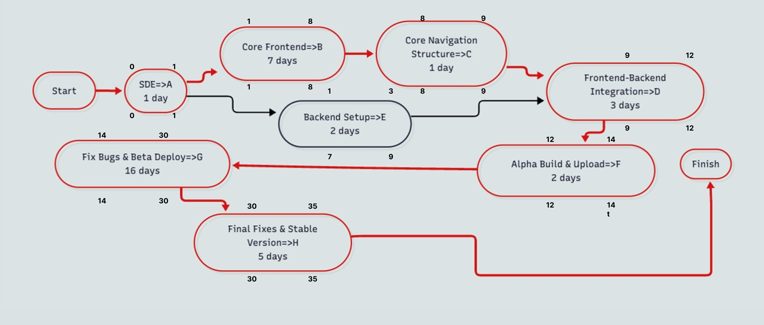
CPM Diagram with Critical Path

Slide 15
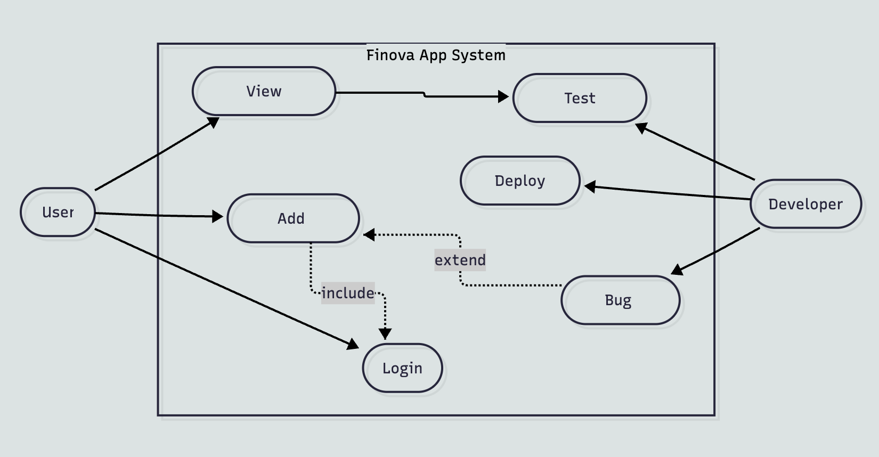
Use Case Diagram

Slide 16
Conclusion
Detailed project planning and requirement gathering ensure the development of a reliable, culturally-sensitive finance management app.
Emphasis on risk management, quality assurance, and user-centered design supports timely delivery and high user satisfaction.
Finova aims to empower users in diverse cultural contexts to build healthier financial habits and achieve financial wellness.

Slide 17


Thank you
I would love to answer any Questions.

